Slide 1
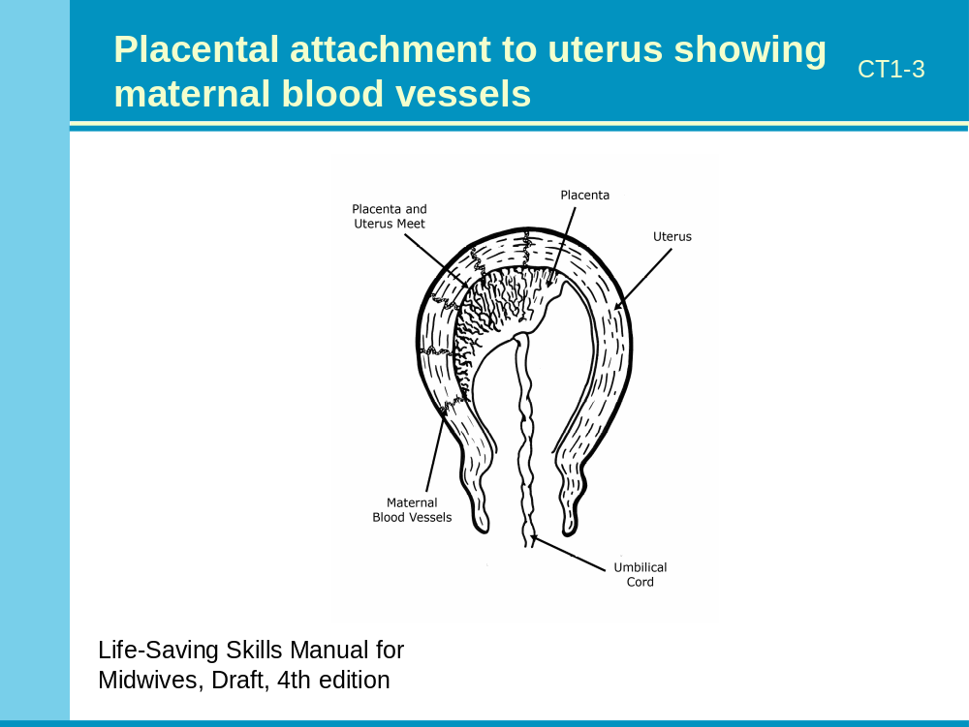
Notes:
Notes to the facilitator:
Ask participants: What causes contractions?
Review definitions of contraction and retraction.
Explain what happens as the uterus contracts and retracts.

Slide 2
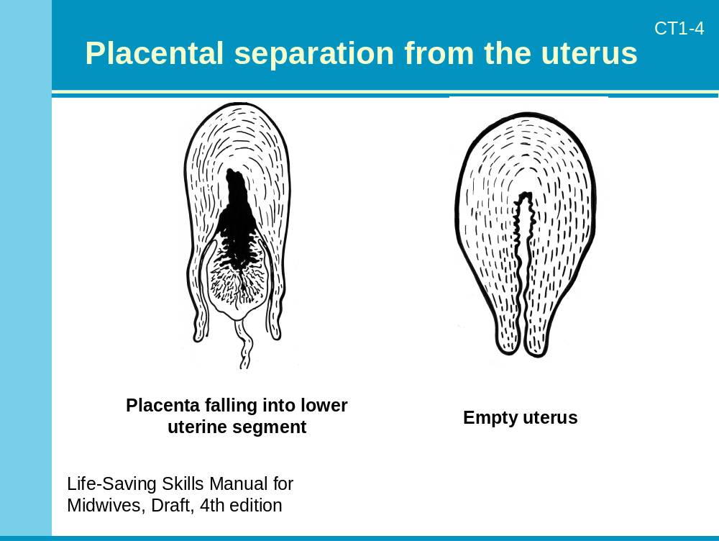
Notes:
Notes to the facilitator:
Using the diagram of the placenta, show the attachment to the uterine wall.
Describe how the uterine muscle fibers constrict the blood vessels where the placenta was attached. This helps control bleeding at the placental site.
Explain how, after separation, the placental site is rapidly covered by a fibrin net and clot formation in the torn vessels is strengthened, leading to decreased bleeding from the site.
The uterus continues to contract after placental separation, forcing the placenta to fall into the lower uterine segment.
Complete this part of the session by reviewing the fact that 90 percent of placentas are delivered within 15 minutes and that when the third stage of labor lasts longer than 30 minutes, PPH occurs six times more often than it does among women whose third stage lasted less than 30 minutes.

Slide 3
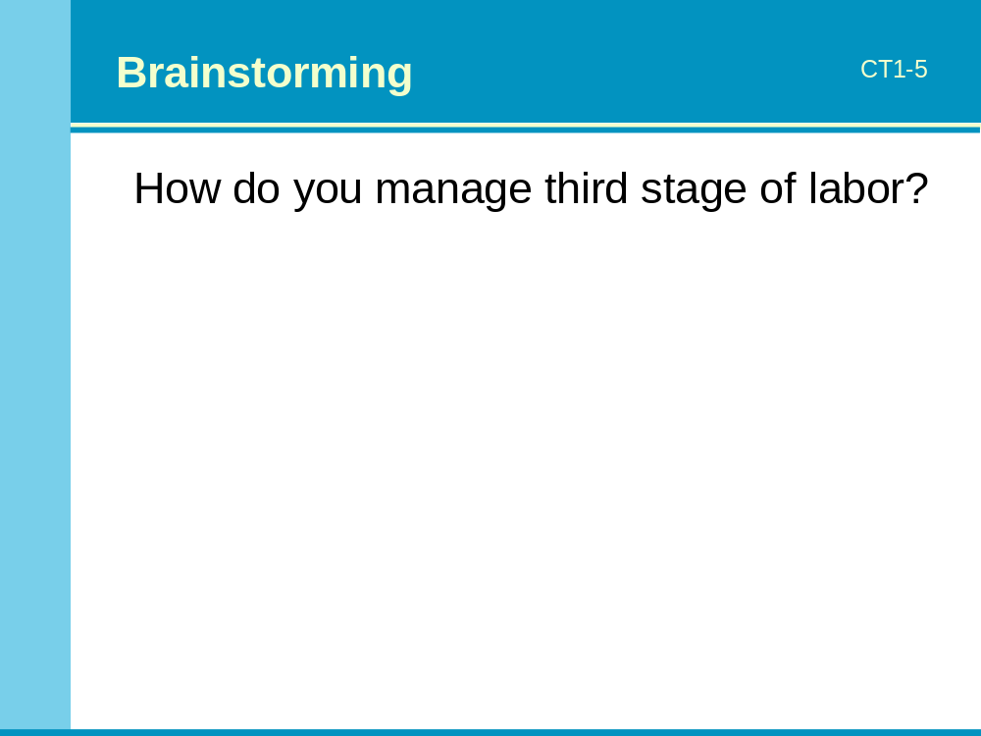
Notes:
Notes to the facilitator:
Ask participants how they manage third stage of labor.
Write their responses on the flipchart.

Slide 4
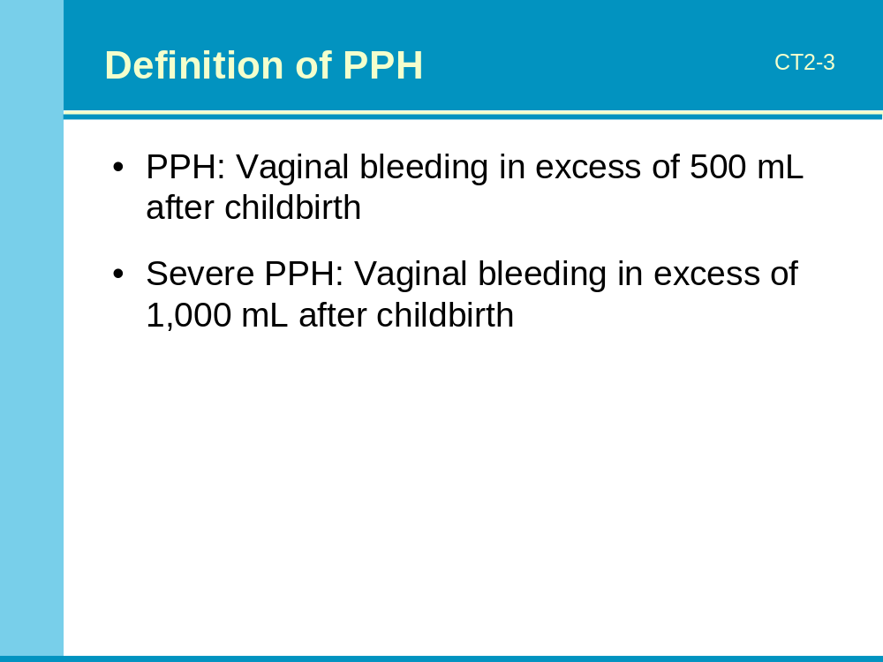
Notes:
Notes to the facilitator:
Before showing the definition, ask participants to explain how they define PPH.
Briefly explain the definitions of PPH and severe PPH.

Slide 5
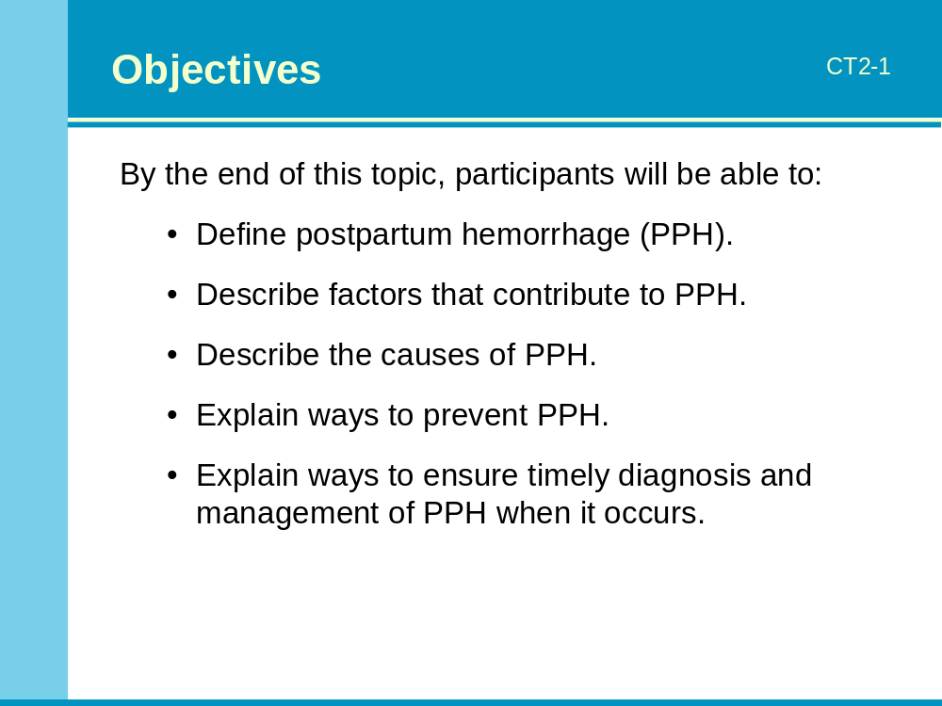
Notes:
Notes to the facilitator:
Introduce the session by presenting the objectives: read the objectives, briefly summarize or ask a participant to read them aloud.

Slide 6
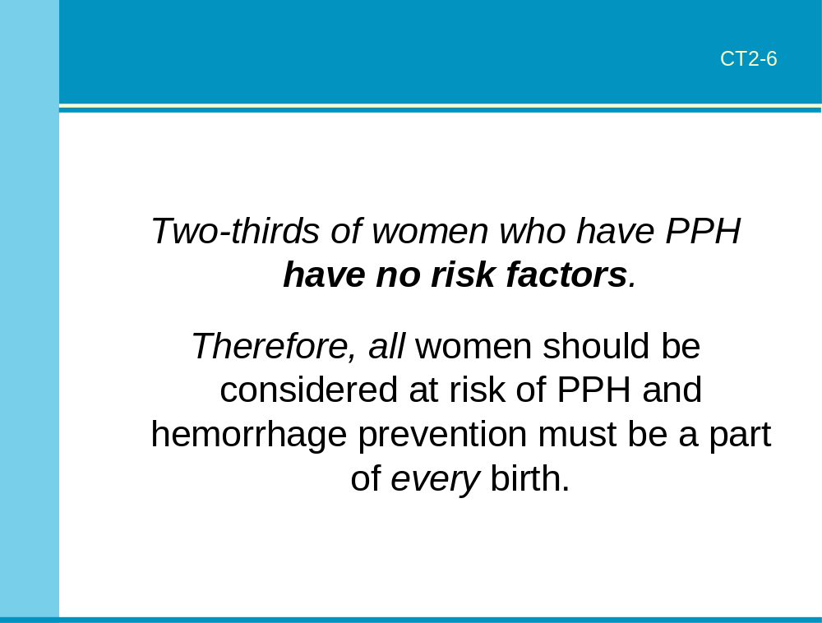
Notes:
Notes to the facilitator:
Ask providers to think about cases of PPH they have managed and to try to remember if the women had identifiable risk factors before having the PPH.
Lead an interactive presentation on why identifying risk factors is not an efficient or effective way of preventing PPH (two-thirds of women who have PPH have no risk factors).
Explain the rationale for considering that all women are at risk of PPH and for promoting interventions to prevent PPH for all women at every birth.
Ask for questions before proceeding.

Slide 7
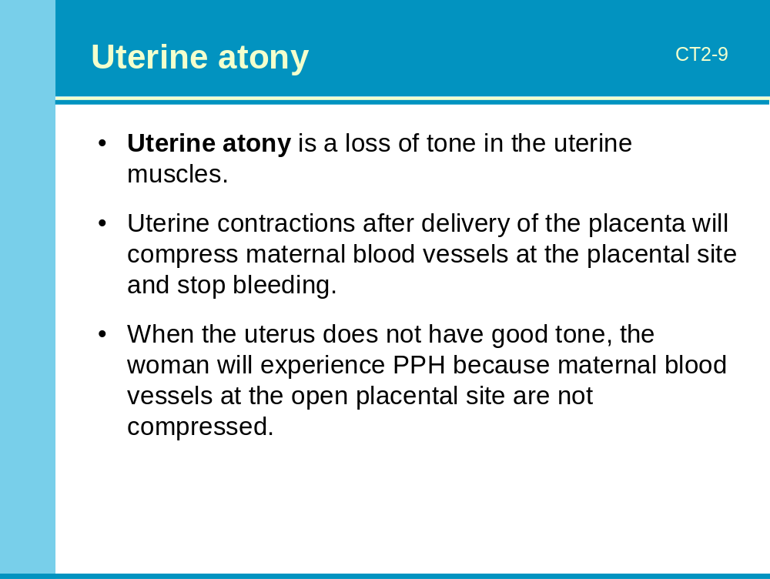
Notes:
Notes to the facilitator:
Define uterine atony and explain how uterine atony causes PPH.

Slide 8
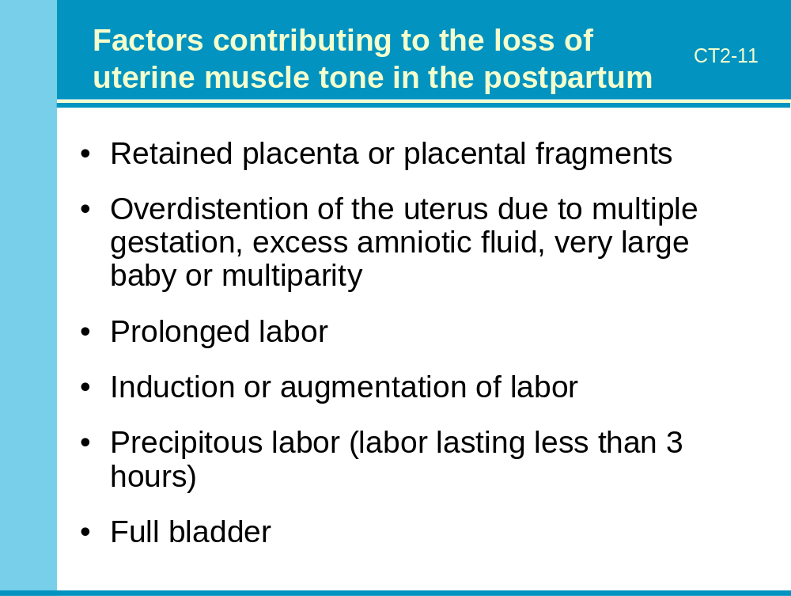
Notes:
Notes to the facilitator:
Complete the participants’ list to ensure that the most common factors contributing to poor uterine tone have been listed.
Emphasize that while there are some known factors that contribute to uterine atony, two-thirds of PPH occurs in women who have absolutely NO risk factors.

Slide 9
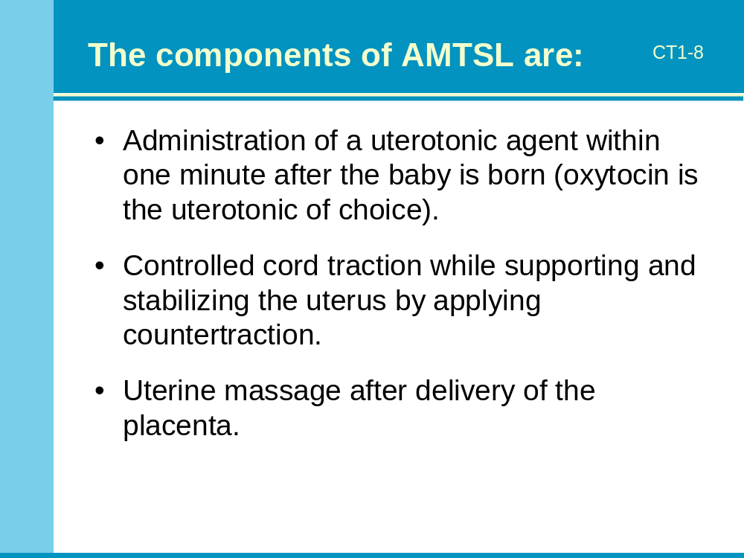
Notes:
Notes to the facilitator:
End this part of the session by reviewing the three components of AMTSL.

Slide 10
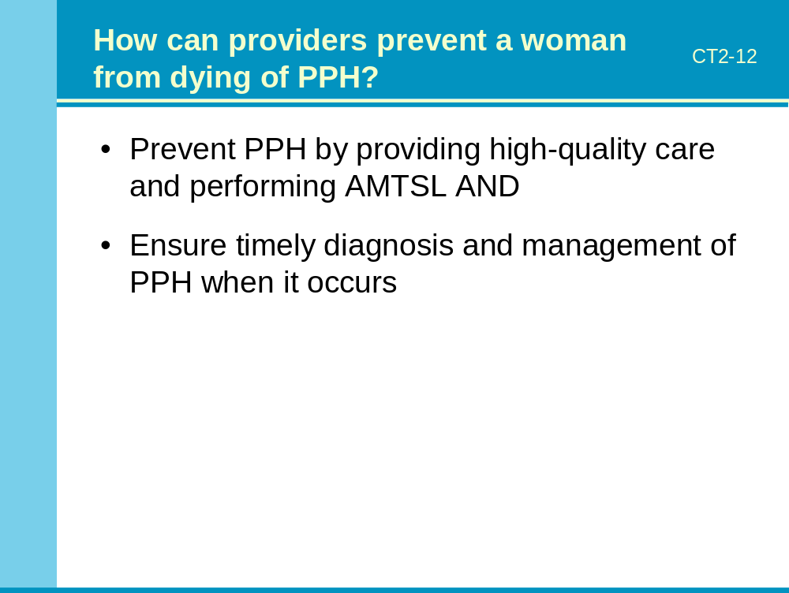
Notes:
Notes to the facilitator:
Begin this portion of the session by explaining that there are two ways to prevent death from PPH:
Prevent PPH by providing high-quality care and performing AMTSL.
AND
Ensure timely diagnosis and management of PPH when it occurs.
Explain that three factors will influence a woman’s prognosis when she has a postpartum hemorrhage:
her hemoglobin,
how quickly PPH is accurately diagnosed, and
how quickly PPH is treated/managed.

Slide 11
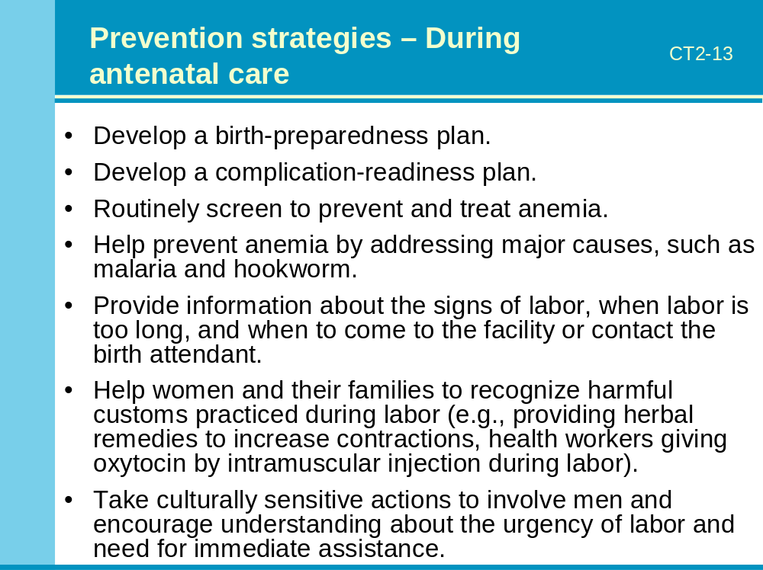
Notes:
Notes to the facilitator:
Ask participants to refer to the section on “PPH prevention and early detection” in Core Topic 2: PPH causes and prevention in the Reference Manual.
For each PPH prevention strategy, ask participants to try to provide an explanation of how the strategy may prevent PPH and/or decrease the likelihood that the woman will die if PPH occurs. Complete their responses as necessary.
Ask for questions before proceeding.

Slide 12
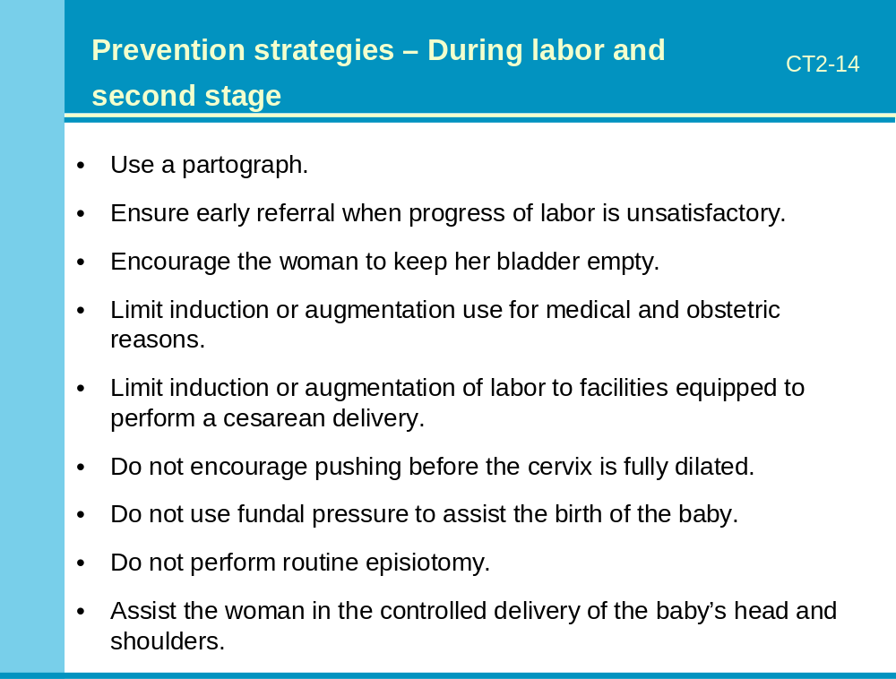
Notes:
Notes to the facilitator:
Ask participants to refer to the section on “PPH prevention and early detection” in Core Topic 2: PPH causes and prevention in the Reference Manual.
For each strategy, ask participants to try to provide an explanation of how the strategy may help prevent death from PPH. Complete their responses as necessary.

Slide 13
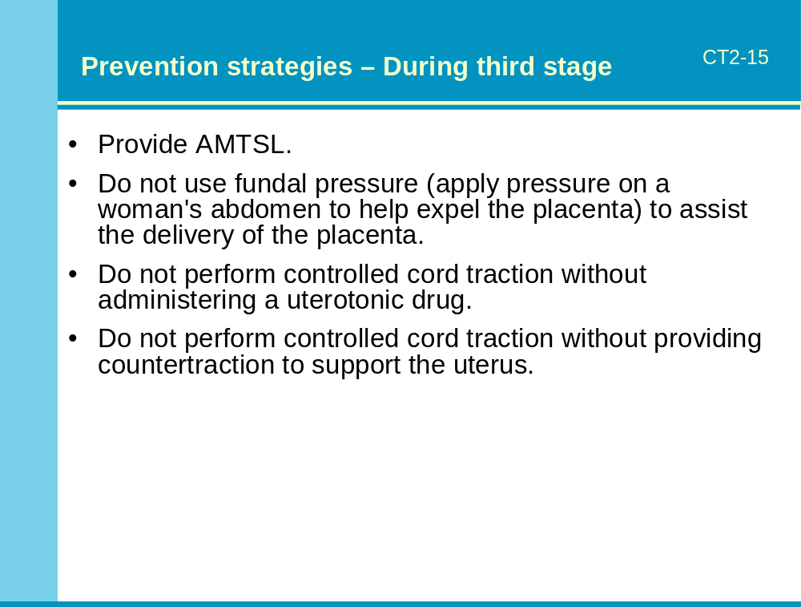
Notes:
Notes to the facilitator:
Ask participants to refer to the section on “PPH prevention and early detection” in Core Topic 2: PPH causes and prevention in the Reference Manual.
For each strategy, ask participants to try to provide an explanation of how the strategy may help prevent death from PPH. Complete their responses as necessary

Slide 14
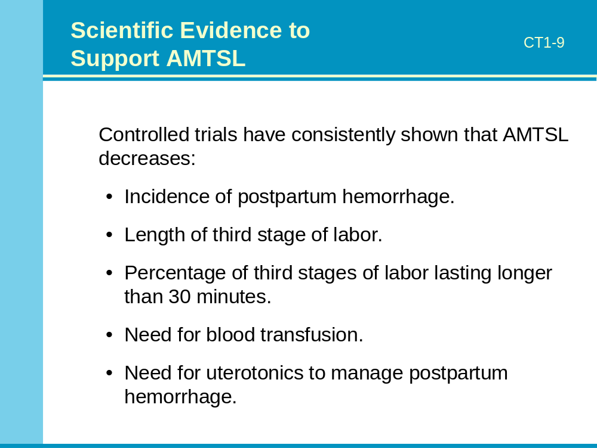
Notes:
Notes to the facilitator:
Present an illustrated lecture explaining the scientific evidence supporting the practice of AMTSL.
Give participants a minute to weigh advantages and disadvantages of each type of management of the third stage of labor and decide which type appears to be more beneficial for the woman.
After a minute or less, ask participants who think AMTSL is more beneficial for the woman to stand.
Ask one or two of the participants standing to explain their reasoning for choosing AMTSL.
If any participants are still seated, ask them to explain why they thought PMTSL was more beneficial for the woman. Answer any questions.

Slide 15
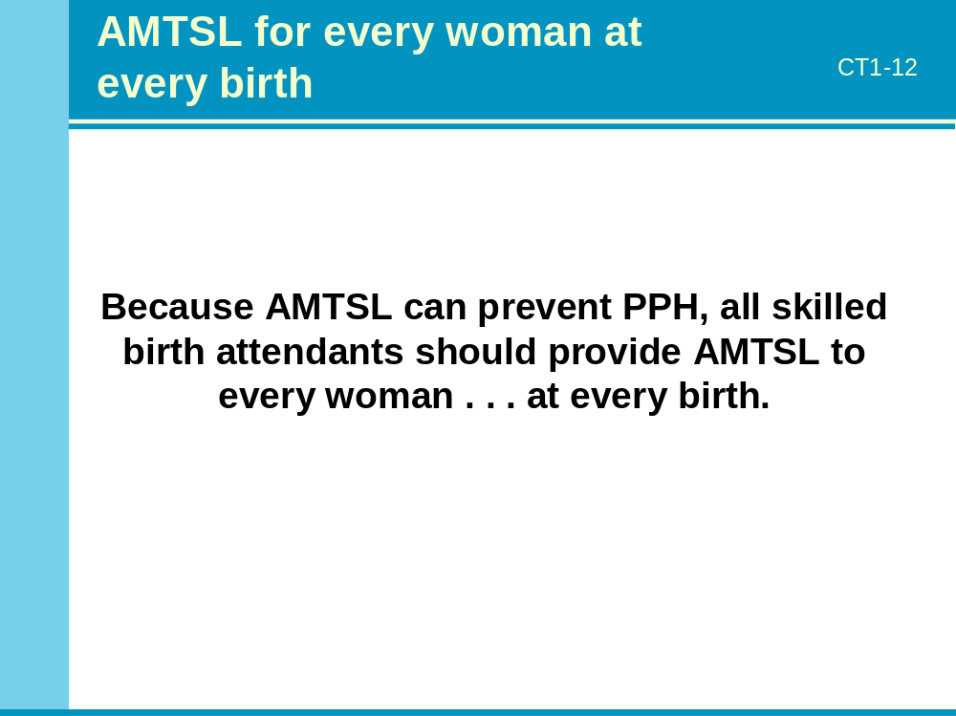
Notes:
Notes to the facilitator:
Explain that each birth attendant has a role to play in reducing maternal deaths due to PPH.
Ask for questions before proceeding.

